Slide 1
Practical Bluetooth Traffic Sniffing: Systems and Privacy Implications
Wahhab Albazrqaoe, Jun Huang, Guoliang Xing
Department of Computer Science and Engineering
Michigan State University

Slide 2
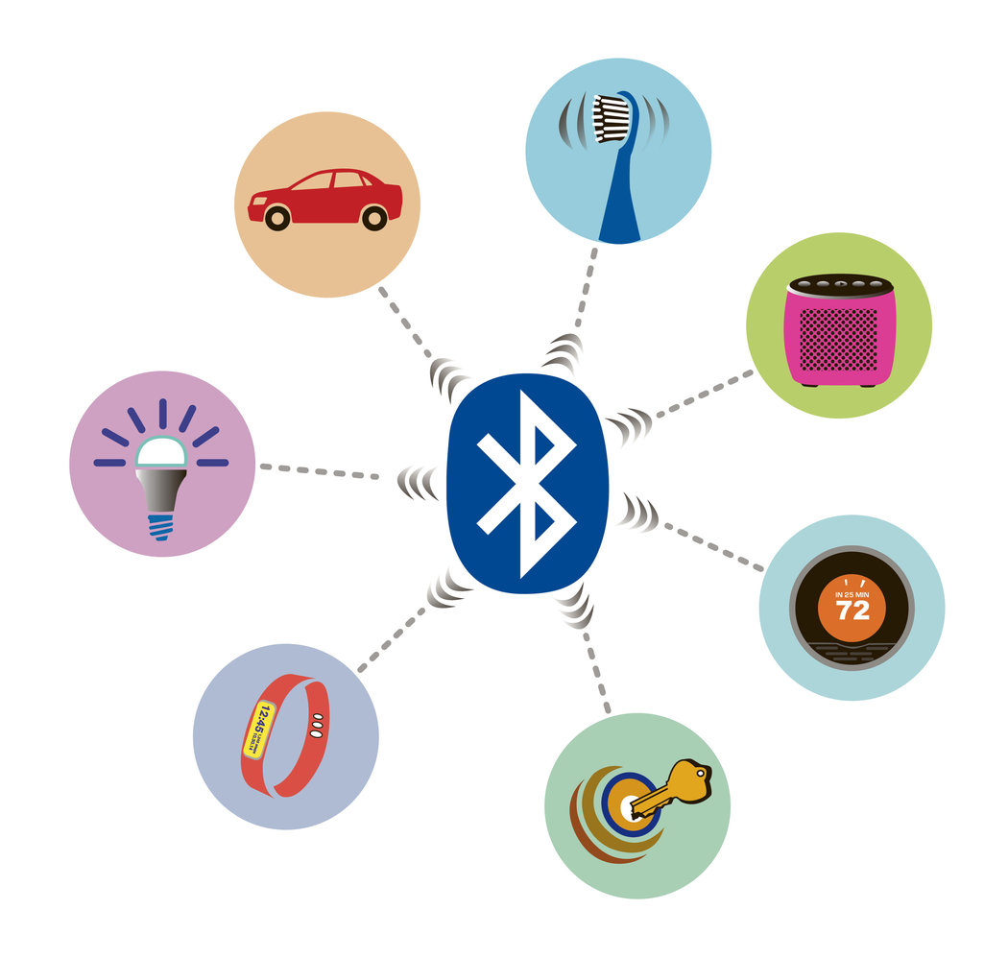
Bluetooth Everywhere
Smart Health
3 billions Bluetooth devices were shipped in 2015
Most applications are privacy-sensitive
Car telematics
Health monitoring
Mobile payment
Connected Cars
Appliances
Lighting
Sensors
Wearables
Locks

Slide 3
Bluetooth Privacy
Bluetooth encrypts packets using a 128-bit key
However, an attacker can …
Sniff the pairing process to retrieve the link key [MobiSys’05]
Capture 44.3 MBs of data to crack encryption in 2³⁸ operations [Crypto’04, Crypto’05]
Inspect traffic pattern to track user activity without decrypting packets [CCS’12, HotMobile’16]

Slide 4
Bluetooth Privacy
Bluetooth encrypts packets using a 128-bit key
However, an attacker can …
Sniff the pairing process to retrieve the link key [MobiSys’05]
Capture 44.3 MBs of data to crack encryption in 2³⁸ operations [Crypto’04, Crypto’05]
Inspect traffic pattern to track user activity without decrypting packets [CCS’12, HotMobile’16]

Slide 5

Is Bluetooth secure to traffic sniffing?

Slide 6
Basic Frequency Hopping
Switch b/w 79 subchannels randomly
1600 hops/s
Device MAC Address
Basic hop sequence generator
Current hop is defined by
Device MAC address (public)
A basic hop seq. of 2²⁷ long
A 27-bit logic clock (secret)
Index of current hop
79
…
50
…
Subchannel
40
…
10
Time
…
…
35
36
…
32
33
34
Clock

Slide 7
Adaptive Frequency Hopping
Remaps `bad’ subchannels
MAC address (public)
Clock (secret)
Remap Function
MAC Addr.
Clock
Vendor-dependent behavior
No standard definition of ‘good’ and ‘bad’ sub- channel conditions
79
…
50
…
Interference
Subchannel
40
…
10
Time
…
Clock

Slide 8
Sniffing Bluetooth Traffic is Challenging
Secret clock value
Don’t know the next hop

Slide 9
Sniffing Bluetooth Traffic is Challenging
Secret clock value
Don’t know the next hop
Vendor-dependent AFH implementation
Difficult to follow adaptive hopping

Slide 10
Sniffing Bluetooth Traffic is Challenging
Secret clock value
Don’t know the next hop
Vendor-dependent AFH implementation
Difficult to follow adaptive hopping
Heavy interference in 2.4 GHz band
Degradation of sniffing performance

Slide 11
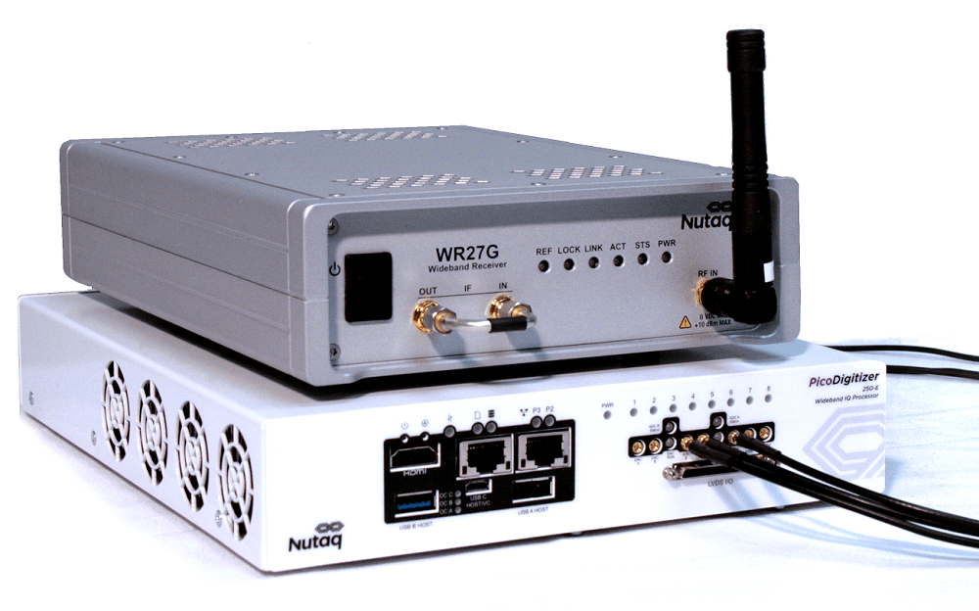
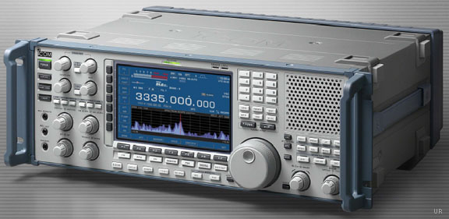
State-of-the-Art Bluetooth Sniffers
Sniff all 79 Bluetooth subchannels in parallel
Need to monitor a total of 83.5 MHz spectrum
Rely on specialized radios for parallel signal processing
Typically cost around $10k to $25k per unit
Nutaq WDXG RF Wideband Digitizer
Icom IC-R9500 wideband receiver
$17,500.00

Slide 12
State-of-the-Art Bluetooth Sniffers
Sniff all 79 Bluetooth subchannels in parallel
Need to monitor a total of 83.5 MHz spectrum
Rely on specialized radios for parallel signal processing
Typically cost around $10k to $25k per unit
Practical Bluetooth sniffer using general, inexpensive, portable wireless platforms ??
Nutaq WDXG RF Wideband Digitizer
Icom IC-R9500 wideband receiver
$17,500.00

Slide 13
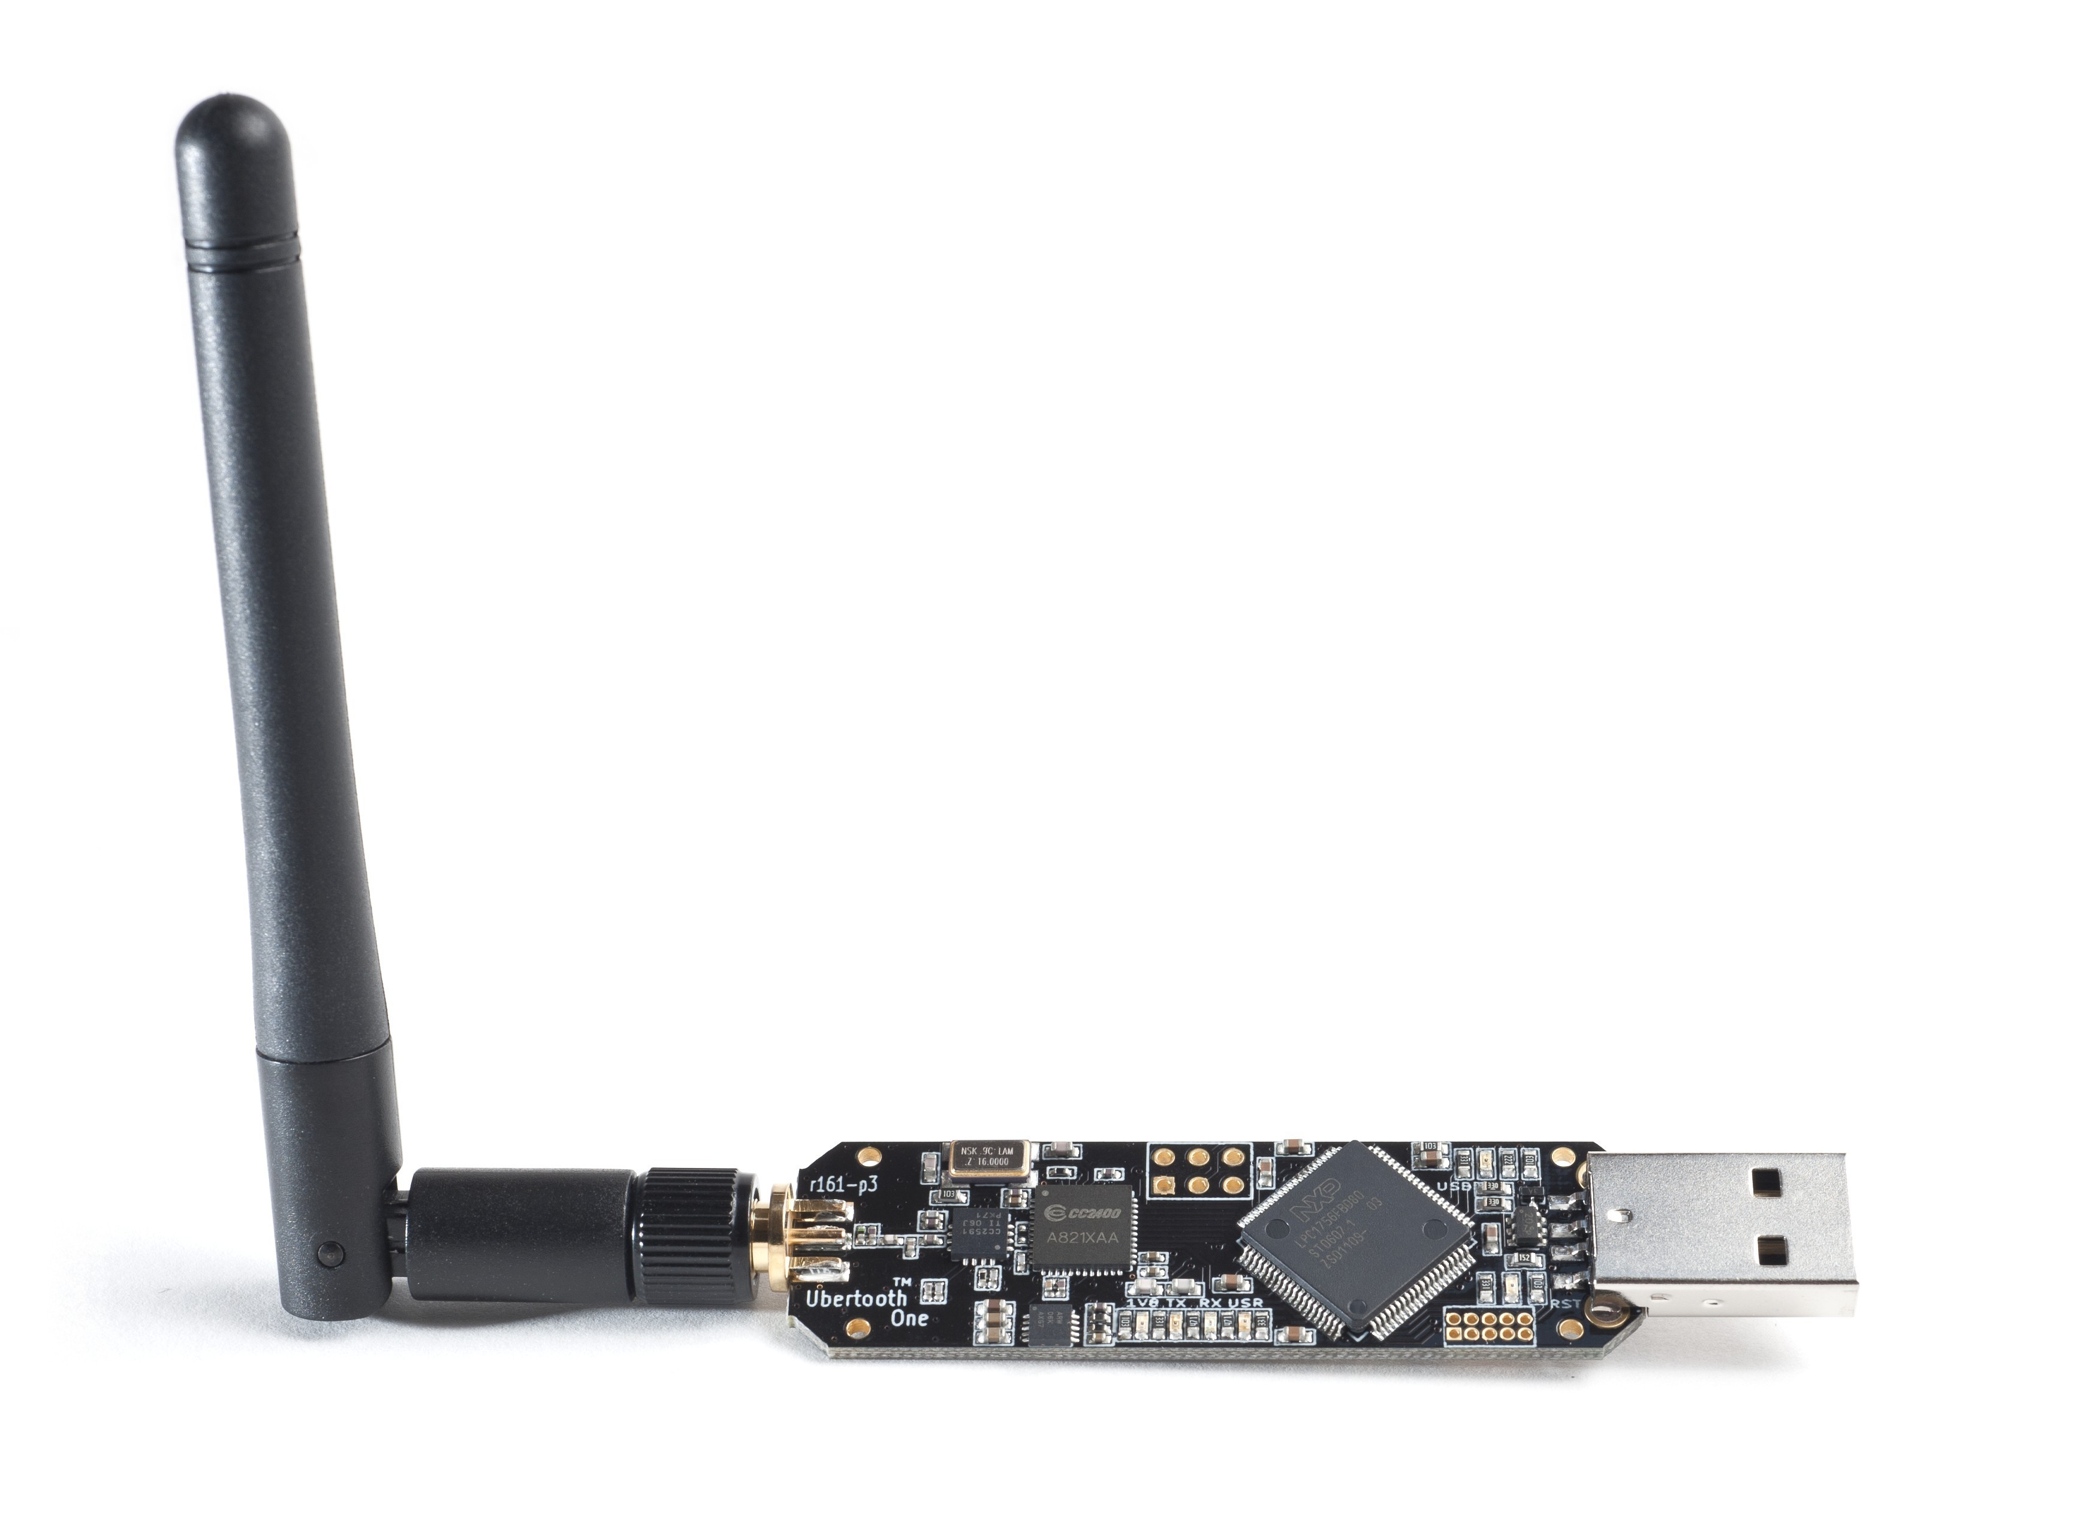
BlueEar: A Dual-Radio Sniffer
The Scout radio
Sniffs a single subchannel to acquire clock value
Perform basic hoping to learn subchannel status
Selectively jam to avoid interference
The Snooper radio
Follow adaptive hopping to capture packets
Scout
Snooper
Clock Acquisition
Basic Hop Selection
Hopping phase
Subchannel Classification
Adaptive Hop Selection
Subchannel status
Selective Jamming

Slide 14
BlueEar: A Dual-Radio Sniffer
The Scout radio
Sniffs a single subchannel to acquire clock value
Perform basic hoping to learn subchannel status
Selectively jam to avoid interference
The Snooper radio
Follow adaptive hopping to capture packets
Scout
Snooper
Clock Acquisition
Basic Hop Selection
Hopping phase
Subchannel Classification
Adaptive Hop Selection
Subchannel status
Seletive Jamming

Slide 15
Brute-force Clock Acquisition
Generate basic hop sequence (BHS)
Basic Hop Sequence Generator
MAC Address
2
1
0
Basic Hop Sequence
Subchannel
…
32 33 34 35 36 37 38
…
Clock

Slide 16
Brute-force Clock Acquisition
Generate basic hop sequence (BHS)
Basic Hop Sequence Generator
MAC Address
2
1
0
Basic Hop Sequence
Stay on subchannel 2 to capture the target’s packets
Subchannel
…
32 33 34 35 36 37 38
…
Clock
2
1
0
Subchannel
? ? ? ?
Clock

Slide 17


Brute-force Clock Acquisition
Generate basic hop sequence (BHS)
Basic Hop Sequence Generator
MAC Address
2
1
0
Basic Hop Sequence
Stay on subchannel 2 to capture the target’s packets
Subchannel
…
32 33 34 35 36 37 38
…
Clock
Compare observed pattern w/ BHS at all clock values
Mismatch at clock 32
2
1
0
Subchannel
? ? ? ?
Clock

Slide 18
Brute-force Clock Acquisition
Generate basic hop sequence (BHS)
Basic Hop Sequence Generator
MAC Address
2
1
0
Basic Hop Sequence
Stay on subchannel 2 to capture the target’s packets
Subchannel
…
32 33 34 35 36 37 38
…
Clock
Compare observed pattern w/ BHS at all clock values
Match at clock 35
2
1
0
Subchannel
? ? ? ?
Clock

Slide 19

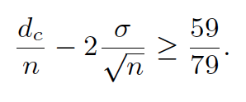
Probabilistic Clock Matching
Goal: Find the correct clock despite remapped packets
Mismatch ratio < 59/79
Update mismatch ratio | a packet captured
Probabilistic Hypothesis Testing
79
…
50
…
Interference
NO
YES
Subchannel
40
Remains as a clock candidate
Eliminate incorrect clock
…
10
Time
…
7

Slide 20
Probabilistic Clock Matching
Goal: Find the correct clock despite remapped packets
Update mismatch ratio | a packet captured
Probabilistic Hypothesis Testing
Prob. of clock matching
NO
YES
Remains as a clock candidate
Eliminate incorrect clock
Average latency < 50 sec
Time

Slide 21
BlueEar: A Dual-Radio Sniffer
The Scout radio
Sniffs a single subchannel to acquire clock value
Perform basic hoping to learn subchannel status
Selectively jam to avoid interference
The Snooper radio
Follow adaptive hopping to capture packets
Scout
Snooper
Clock Acquisition
Basic Hop Selection
Hopping phase
Subchannel Classification
Adaptive Hop Selection
Subchannel status
Selective Jamming

Slide 22
Packet-based Channel Classifier
X clear?
Yes
TX on Channel X
Sense Channel X
Sense Channel X
No
Remap to Channel Y

Slide 23
Packet-based Channel Classifier
X clear?
Yes
TX on Channel X
Sense Channel X
Sense Channel X
No
Remap to Channel Y
Scout visits all subchannels
Collect packet statistics
Compute prob. of `bad’ subchannel

Slide 24
Packet-based Channel Classifier
X clear?
Yes
TX on Channel X
Sense Channel X
Sense Channel X
No
Remap to Channel Y
Robust to vendor-dependent implementations
Need to capture sufficient packets

Slide 25
RSS-based Channel Classifier
Classify subchannels based on interference condition
PDF of received signal strength (RSS) as feature
Noise floor
Interference
RSS (dBm)
RSS (dBm)

Slide 26
RSS-based Channel Classifier
Classify subchannels based on interference condition
PDF of received signal strength (RSS) as feature
Low classification delay
Poor accuracy
Spectrum context disparity
Oblivious to vendor-dependent impl.
Noise floor
Interference
RSS (dBm)
RSS (dBm)

Slide 27
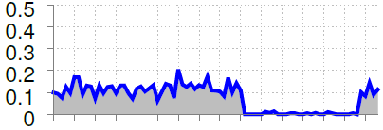
Hybrid Classifier
Scout
Snooper
Leverage accurate packet-based classifier to train SVM
Subchannel status
RSS-based classifier
Hybrid classifier
Packet-based classifier
Pkt rate
Subchannel index
Packet Rate Measurement

Slide 28
Hybrid Classifier
Scout
Snooper
Leverage accurate packet-based classifier to train SVM
Subchannel status
RSS-based classifier
Hybrid classifier
Packet-based classifier
Subchannel status
Good
Good
…
Bad
Packet-based Classifier
Pkt rate
Subchannel index
Packet Rate Measurement

Slide 29
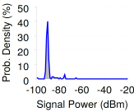
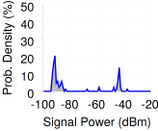
Hybrid Classifier
Scout
Snooper
Leverage accurate packet-based classifier to train SVM
Subchannel status
RSS-based classifier
Hybrid classifier
Packet-based classifier
Subchannel status
Good
Good
…
Bad
Packet-based Classifier
Signal features
Pkt rate
Subchannel index
Interference Measurement
Packet Rate Measurement

Slide 30
Hybrid Classifier
Scout
Snooper
Leverage accurate packet-based classifier to train SVM
Employ SVM for responsive classification
Fallback to packet-based classifier when SVM’s confidence is low
Subchannel status
RSS-based classifier
Hybrid classifier
Packet-based classifier
SVM
Train
Subchannel status
Good
Good
…
Bad
Packet-based Classifier
Signal features
Pkt rate
Subchannel index
Interference Measurement
Packet Rate Measurement

Slide 31
BlueEar: A Dual-Radio System
The Scout radio
Sniffs a single subchannel to acquire clock value
Perform basic hoping to learn subchannel status
Selectively jam to avoid interference
The Snooper radio
Follow adaptive hopping to capture packets
Scout
Snooper
Clock Acquisition
Basic Hop Selection
Hopping phase
Subchannel Classification
Adaptive Hop Selection
Subchannel status
Selective Jamming

Slide 32
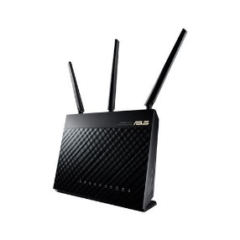
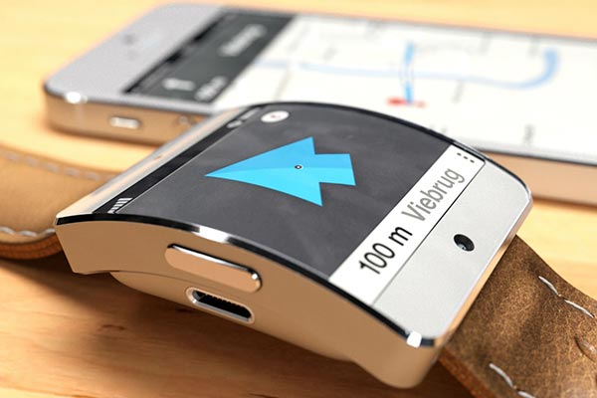
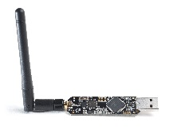
Selective Jamming
WiFi AP @2433MHz
Bluetooth Target
BlueEar
Bad sniffing on Channel X
Jam X to drive the target away
Enforced cooperation to avoid interference

Slide 33
Implementation
Implmented on two Ubertooth, costs $160
Optimized Ubertooth firmware for real-time hopping
Offloading computation-intensive tasks to commodity laptop
Experiment setup
52 Bluetooth devices (headsets, smartphones …)
Baseline – Basic hopping sniffer, no selective jamming
Benchmarks with controlled interference
Collocated with a Wi-Fi based enterprise WLAN

Slide 34
Packet Capture Rate
different locations of an office-building
>90% capture rate w/ interference from a large-scale, commodity Wi-Fi network

Slide 35
Packet Capture Rate
high packet capture rate up to 20 meters

Slide 36
Practical Countermeasure
Pseudo-randomly flip subchannel status
Disturb the clock acquisition algorithm
Interfere with subchannel classification
Can be implemented using a user-space script
No modification to peripheral devices
Excellent
Excellent
Good
Good
Fair
Fair
Mean opinion score
Mean opinion score
Poor
Poor
Bad
Bad
(a) Without countermeasure
(b) With countermeasure

Slide 37
Conclusion
BlueEar: A dual-radio system for Bluetooth traffic sniffing
Sniff Bluetooth traffic based on novel architecture and algorithms
Implement using general, inexpensive wireless hardware
Maintain high packet capture rate despite complex interference conditions
Privacy Implications and Countermeasure
Re-define the bar of Bluetooth traffic sniffing
Reducing sniffer cost by 100-fold
Call for research efforts for enhancing Bluetooth security
Explored simple and practical countermeasure

Slide 38
Thank you !
Q/A

